Slide 1
Android full stack development
Abdullah Muhammad
Silika

Slide 2
AGENDA
Overview of Android full stack development​
Explanation of your app concept and its significance ​Demonstration of your Figma design
Overview of using Git for version control
​Showcase your Git repository with commits and version history ​

Slide 3
Android full stack developer
A full-stack developer is a master of both the front-end (user interface) and back-end (server-side logic) of an application.
In Android development, a full-stack developer crafts the entire app experience, from the intuitive user interface users interact with to the robust back-end that powers app functionality.
This diverse skillset enables full-stack developers to bring their app ideas to life independently or seamlessly collaborate with specialized front-end and back-end developers.

Slide 4
FuelDrop: Delivering Fuel Convenience at Your Fingertips
FuelDrop is a revolutionary mobile application designed to simplify and streamline the process of getting fuel for your vehicle. Imagine skipping the gas station queues and having fuel delivered directly to your location – that's the power of FuelDrop!
Target Audience:
Busy professionals who value their time
Individuals in remote areas with limited gas station access
Anyone seeking a convenient and hassle-free fuel delivery solution

Slide 5
Core Functionalities:
User-friendly Interface: Effortlessly register, order fuel, track deliveries, and manage your account.
Real-time Tracking: Stay informed on your order status with estimated delivery times.
Multiple Payment Options: Choose your preferred method – cash on delivery, credit/debit card, or mobile wallets.
Safety First: Enjoy peace of mind knowing professional drivers and safety protocols ensure a smooth experience.
Emergency Support: Receive prompt assistance in case of unexpected situations like running out of fuel or delivery delays.
Benefits:
Convenience: Save time and avoid gas station queues, getting fuel delivered directly to your doorstep.
Efficiency: Focus on your day while FuelDrop takes care of your fuel needs.
Reduced Emissions: Contribute to a greener environment by minimizing unnecessary trips to gas stations.

Slide 6
Key Features:
User Panel: Register, order, track, and manage your fuel deliveries.
Delivery Agent Panel: View and accept orders, update delivery status, and communicate with users.
Admin Panel: Manage users, agents, suppliers, analyze data, and optimize operations.
FuelDrop is poised to revolutionize the fuel delivery landscape, offering convenience, efficiency, and eco-friendliness to users on the go. Download the app today and experience the future of fuel delivery!

Slide 7
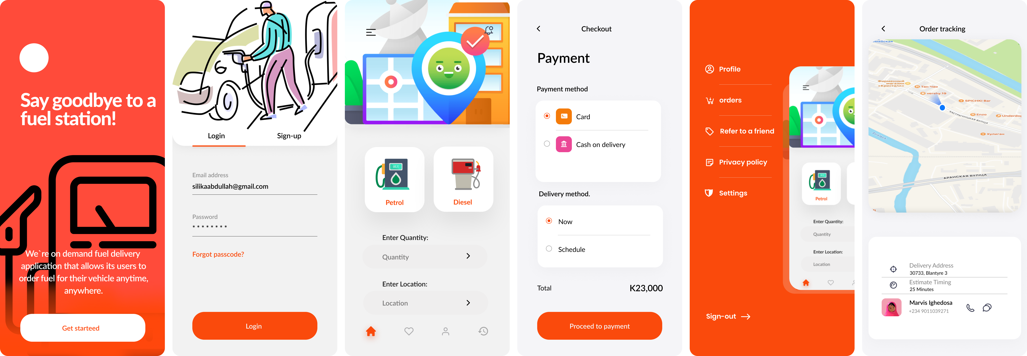

Slide 8
Introducing Git: Your Version Control Hero
Version control is a system that records changes to a file or set of files over time so that you can recall specific versions later
Git is a powerful version control system that tracks changes made to your codebase over time.
It allows you to:
Revert to previous versions if needed.
Collaborate with others seamlessly by merging code changes effectively.
Maintain a clear history of your project's evolution

Slide 9
THANK YOU
Abdullah Muhammad Silika
silikaabdullah@gmail.com
+265 991 006 765

